Slide 1



HR Data Analysis Dashboard wer bi).
HR analysis dashboard to empower organizations with data-driven insights for enhancing employee performance and retention.
by pramod nemagouda

Slide 2
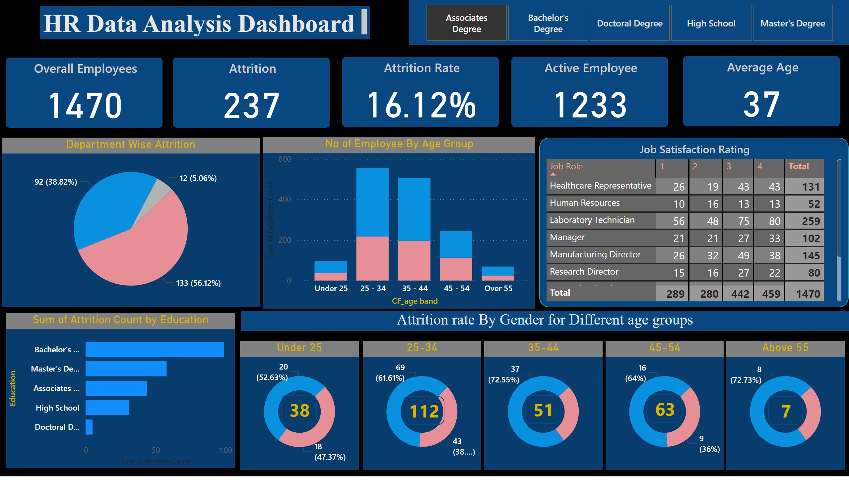
HR Data Analysis Dashboard

Slide 3
Domain Knowledge:
Employee Performance and Retention:
Attrition: This is the rate at which employees leave the organization. A high attrition rate can be costly and disrupt operations.
Retention: This refers to an organization's ability to keep its employees. Retaining top talent is crucial for maintaining a skilled workforce and achieving business goals.
Employee Engagement: This describes the level of emotional commitment employees have to their organization and work. Engaged employees are typically more productive and less likely to leave.
Understanding the Impact of Different Factors:
Job Satisfaction: Employees who are dissatisfied with their work are more likely to leave. The dashboard can help identify departments or roles with lower job satisfaction, prompting further investigation.
Job Role: Certain job roles may be inherently more prone to attrition due to factors like workload, stress, or career advancement opportunities.
Salary and Compensation: Competitive salaries and benefits are important for retaining talent. Analyzing attrition by salary can reveal potential issues with pay equity.
Tenure: Employees who are new to the company may be more likely to leave during the probationary period. Analyzing attrition by year at the company can help assess the effectiveness of onboarding programs.

Slide 4
Objective:
Developed a comprehensive HR analysis dashboard to empower organizations with data-driven insights for enhancing employee performance and retention.
Approach:
Data Understanding: Thorough exploration and preparation of the dataset using Power Query to ensure usability.
Data Cleaning: Eliminating errors, null values, and irrelevant columns via Power Query editor for pristine data.
Data Analysis: Leveraging DAX to derive calculated columns and measures, unveiling patterns and trends.
Data Insights: Visualizing key findings through various KPIs for effective communication.

Slide 5
Key Features
Visualize Attrition Trends: Track changes in attrition rate over time to identify periods of higher turnover.
Drill Down by Demographics: Analyze attrition by factors like gender, age, and education to identify potential biases.
Compare Departments: Benchmark attrition rates across departments to see where retention efforts might be most needed.
Uncover Job Role Impact: Identify job roles with higher attrition and investigate factors like workload or advancement opportunities.
Salary and Retention: Analyze attrition by salary range to identify potential pay equity issues impacting retention.
Tenure and Onboarding: Track attrition by year at the company to assess the effectiveness of onboarding programs.
Job Satisfaction Link: Explore potential connections between job satisfaction surveys and attrition rates for different departments.

Slide 6
Data Requirements
Marital Status | Employee's marital status (Married, Single, Divorced)
Over Time | Overtime work frequency (dummy variable - Yes/No)
Over18 | Dummy variable indicating employee is over 18 (likely always Yes)
Training Times | Number of training sessions attended in the last year
Last Year -2 | Possibly a performance rating or score from 2 years ago (unclear)
Age | Employee's age
CF_current | Dummy variable for current employment status (likely always Yes)
Employee Daily Rate | Employee's daily pay rate
Distance From Home | Employee's commute distance
Education Employee Count | Number of employees with the same education level (redundant with Education)
Environment Satisfaction | Employee satisfaction with the work environment (score 1-4)
Hourly Rate | Employee's hourly pay rate (redundant with Employee Daily Rate?)
Job Involvement | Employee's level of involvement in their job (score 1-4)
Attrition | Employee turnover (Yes - left, No - currently employed)
Business Travel | Frequency of business travel (Travel_Rarely, Travel_Frequently)
CF_age band | Age range (e.g., 25-34)
CF_attrition label | Dummy variable for attrition (Yes - left, No - currently employed)
Department | Employee's department (e.g., Sales, R&D)
Education | Employee's highest level of education (e.g., High School, Associates Degree)
Field | Employee's specific field within the company (e.g., Sales, Life Sciences)
emp no | Unique employee number
Employee Number | Another unique employee identifier (may be the same as emp no)
Gender | Employee's gender (Male, Female)
Job Role | Employee's job title (e.g., Sales Executive, Laboratory Technician)

Slide 7
Job Involvement | Employee's level of involvement in their job (score 1-4)
Job Level | Employee's job level within the company (score 1-4)
Job Satisfaction | Employee satisfaction with their job (score 1-4)
Monthly Income | Employee's monthly income
Monthly Rate | Employee's monthly pay rate (redundant with Monthly Income?)
Num Companies Worked | Number of companies the employee has worked for
Percent Salary Hike | Employee's recent salary increase percentage
Performance Rating | Employee's performance rating (score 1-4)
Relationship Satisfaction | Employee satisfaction with their work relationships (score 1-4)
Standard Hours | Standard number of work hours per week (likely 80 for all employees)
Stock Option Level | Employee's stock option level (score 0-3)
Total Working Years | Employee's total years of work experience
Work Life Balance | Employee's work-life balance satisfaction (score 1-4)
Years At Company | Number of years the employee has been with the company
Years In Current Role | Number of years in the employee's current role
Years Since Last Promotion | Number of years since the employee's last promotion
Years With Curr Manager | Number of years working with the current manager
Attrition Count | Number of times the employee has left the company (always 1 in this dataset)
Sort Age | Sorting criteria based on age (unclear purpose)

Slide 8
KPIs Included:
Total Employees, Attrition Count, and Attrition Rate
Attrition by Gender, Education Field, Age, Salary, Job Role, Year at Company
Attrition by Job Role based on Job Satisfaction
Additionally, we provide insights such as employee count, attrition numbers, attrition rate, and average age.

